Slide 1
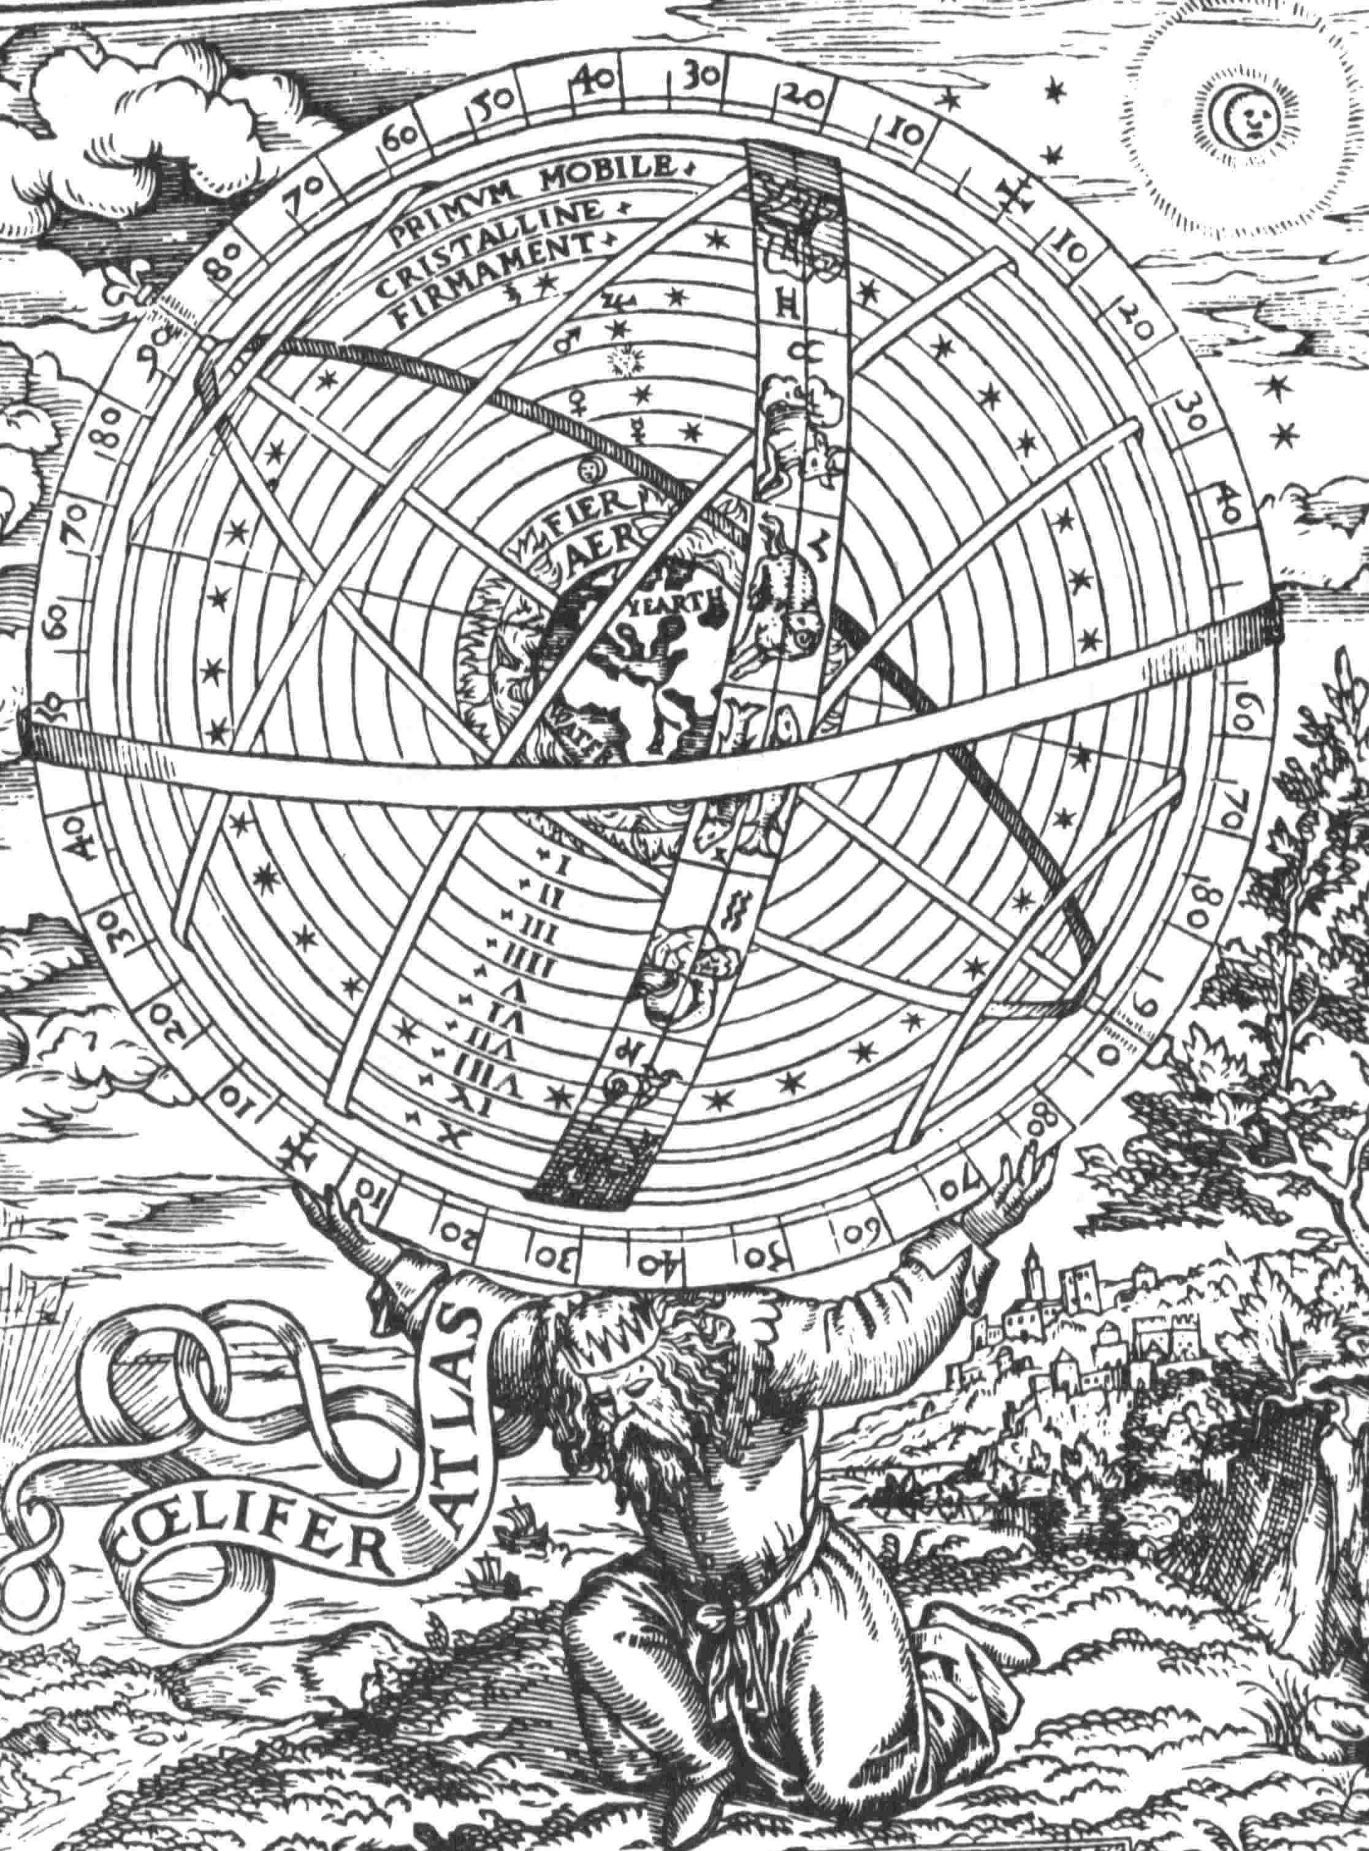

Slide 2
The Process of Reasoning
1. Observe and Question. The first stage requires us to gather as much information as we can about one’s situation and one’s problems. This stage is studied in chapters 1 and 2, where we discuss questions, and various good and bad thinking habits.
2. Examine Possibilities. This stage teaches a few techniques and skills that can help us tell the difference between good and bad answers to your questions. We study these skills in chapters 3 and 4, when we look at arguments, and fallacies.
3. Make Your Decision. The process of reasoning almost always ends with some kind of judgment, or choice, or decision to be made, whether it’s a decision what to believe, or about what to do. This stage is covered in chapters 5 and 6, when we look at reasonable doubt, and moral reasoning.
4. Observe and Question Again. The last stage involves observing and questioning one’s decisions, and whatever consequences might have followed from them, which brings us back to the beginning of the process.

Slide 3
The Idea of a World View
Your usual way of thinking about anything and everything is always influenced by your world view.
This is normal and natural, and usually not a problem.
But to learn to think clearly, rationally, and autonomously, it is very important to know what your world view is, where it came from, and how much it influences you.
It can also be important to recognise different world views held by other people, and to know how to sort out miscommunications and conflicts that can arise between people who hold different world views.
Notes:
Criteria for a world view:
- A world view must be rational, it is realistic and is something capable of having in our society
- A world view must be ethical- tells you something about what right/wrong is. Helps us become better people.
- A world view must be optimistic. It has to generally assume that it is better to be alive and than to die. Life is worth living. It is bad to kill was also part of it.

Slide 4
We learn our first world-views from a lot of different sources, and we learn them while we are still very young.
Parents, grandparents, aunts, uncles, etc.
Friends and peers
School teachers
Television, film, and mass media
Religious leaders
Political propaganda
These sources form our various intellectual environments. Can you think of any more examples?

Slide 5
Some world views are so widely accepted, historically influential, or hugely popular, that they have been given names.
Modernism
Environmentalism
Heliocentrism
The New Age
Democracy
Romanticism
Christianity
Industrialism
Islam
Capitalism
Marxism
Feminism

Slide 6
An intellectual environment will have a character of its own. That is: in one place or among one group of people, one idea or group of related ideas may be more prevalent than other ideas. In another place and among other people, a different set of ideas may dominate things.
Note also that you probably live in more than one social environment, and so you are probably hearing prevalent ideas from more than one intellectual environment too.
6
Notes:
An intellectual environment, simply put, is a community where people talk to each other about their thoughts and their answers to their big questions in life.
We develop our world views based on our problems and our limit situations
A limit situation is an event that force people to realize the way they usually think of things needs to change. A decision that you make that will irreversibly change your life.
When you’re confronted with a massive decision/problem/circumstance that forces you to think about things in a new way.
Our world views also come from our questions.

Slide 7
Obviously, people can still do their own thinking, wherever they are. And this is not to say that the contents of your intellectual environment will always be the same from one day to the next.
But this is to say that wherever you are, and whatever community you happen to be living in or moving through, the prevalent ideas that are expressed and shared by the people around you will influence your own thinking and your life in profound and often unexpected ways.

Slide 8
Eventually, the ideas that you gathered from your intellectual environment, along with a few ideas of your own that you develop on the way, come together in your mind. They form in your mind a kind of plan, a picture, or a model, of what the world is like, and how it acts, and so on. This plan helps you to understand things, and also helps you make decisions.
Philosophers sometimes call this plan a world view.
7

Slide 9
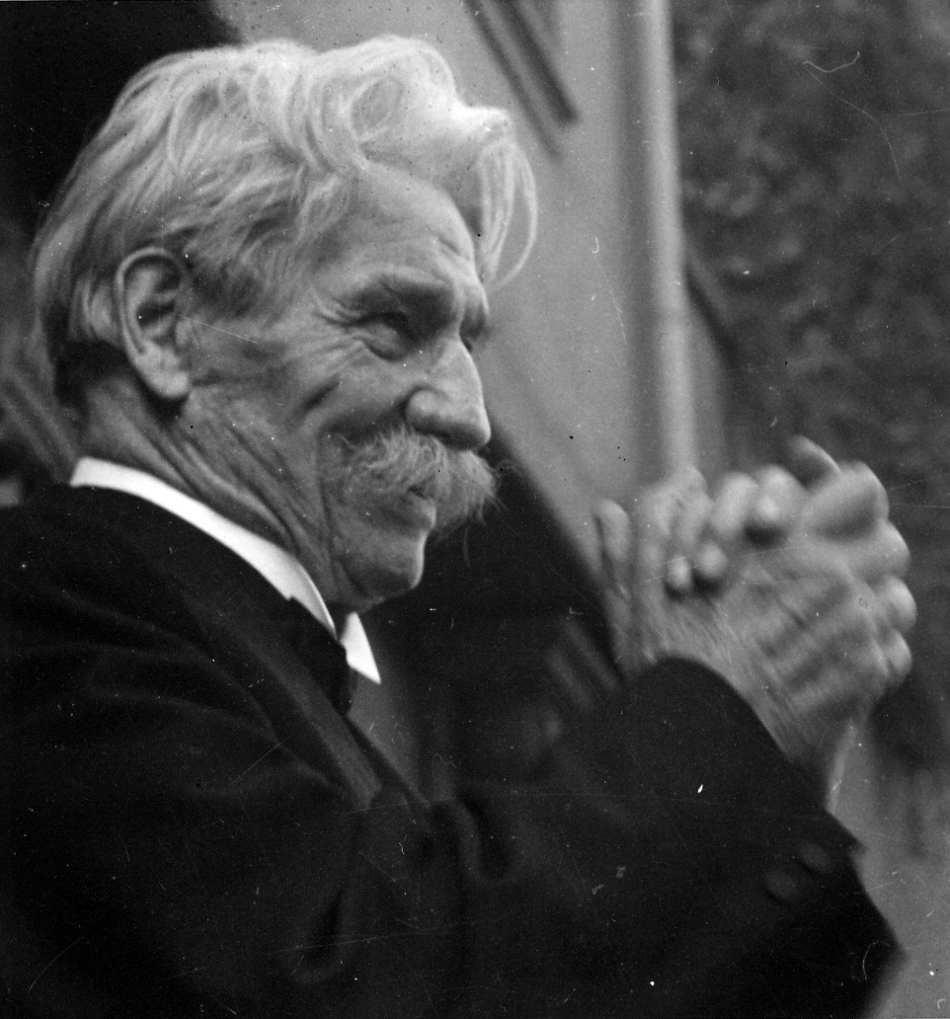
The word ‘world view’ was first coined by German philosopher Albert Schweitzer in a book called “The Decay and Restoration of Civilization”, first published 1923.

Slide 10
Here’s how Schweitzer himself defined what a world view is.
The greatest of the spirit’s tasks is to produce a theory of the universe.* What is meant by a theory of the universe? It is the content of the thoughts of society and the individuals which compose it about the nature and object of the world in which they live, and the position and the destiny of mankind and of individual men within it. What significance has the society in which I live and I myself in the world? What do we want to do in the world? What do we hope to get from it? What is our duty to it? The answer given by the majority to these fundamental questions about existence decides what the spirit is in which they and their age live.
(Schweitzer, The Decay and Restoration of Civilisation, pg. 80-1)
* Weltanshauung: ‘world view’, ‘world conception’, or ‘theory of the universe’.

Slide 11
The idea here is that a world-view is more than a group of beliefs about the nature of the world. It is also a bridge between those scientific or metaphysical beliefs, and the ethical beliefs about what people can and should do in response to the world. It is the intellectual narrative in terms of which the actions, choices, and purposes of individuals and groups make sense. It therefore has indispensable practical utility: it is the justification for a way of life, for individuals and for whole societies. And we cannot live without one.
“For individuals as for the community, life without a theory of things is a pathological disturbance of the higher capacity for self-direction.”
(Schweitzer, ibid, pg. 86)

Slide 12
Here’s my definition:
A world view is the sum of a set of related answers to the most important questions in life.
Your own world view, whatever it is, will be the sum of your own answers to the most important questions in life, whatever you take those questions to be, and whether you have thought about them consciously or not.
Thus your world view is intimately tied to your sense of who you are, how you want to live, how you see your place in your world, and the things that are important to you.
And by the way, that’s a big part of why people don’t like hearing criticism. A judgment of a world view is often taken to be a judgment of one’s self and identity. But it doesn’t have to be that way.

Slide 13
Framing Languages
One of the ways that your intellectual environment and your world view expresses itself is in the use of framing language. These are the words, phrases, metaphors, symbols, definitions, grammatical structures, questions, and so on, which we use to think and speak of things in a certain way.
We frame things by describing or defining them with certain interpretations in mind. We also frame things by the way we place emphasis on certain words and not on others. And we frame things by interpreting and responding selectively to things said by others.
12

Slide 14
Consider this example of how framing language affects how we think about things:
“In the year 1605, Guy Fawkes attempted to start a people’s revolution against corruption, inherited privilege, and social injustice, in the British government.”
“In the year 1605, Guy Fawkes planned a terrorist attack against against a group of Protestant politicians, in an attempt to install a Catholic theocracy in Britain.”
13

Slide 15
Both of these statements, taken as statements of fact, are true. But they are both framed very differently.
In the first statement, Fawkes is portrayed as a courageous political activist.
In the second, he is framed (!) as a dangerous religious fanatic.
And because of the different frames, they lead the reader to understand and interpret the man’s life and purposes very differently. This, in turn, leads the reader to draw different conclusions.
14

Slide 16
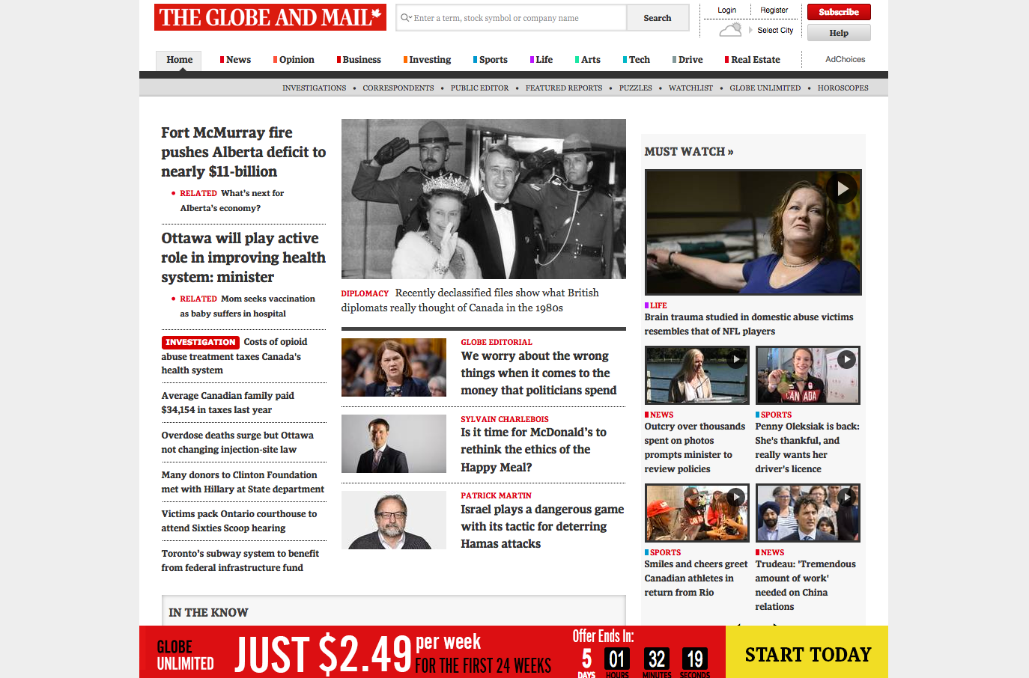
15
15

Slide 17
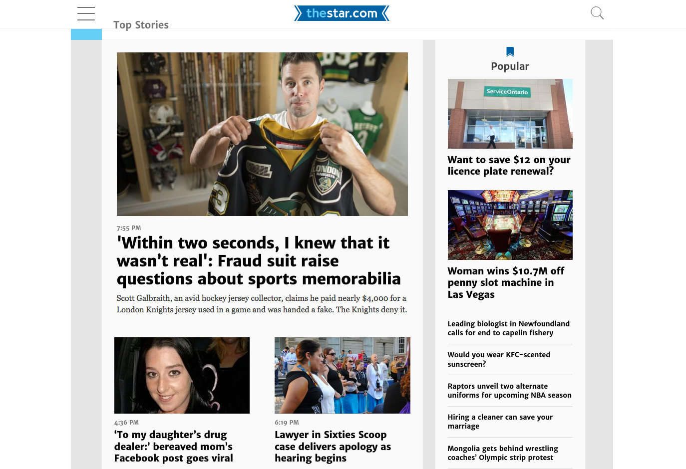

Slide 18
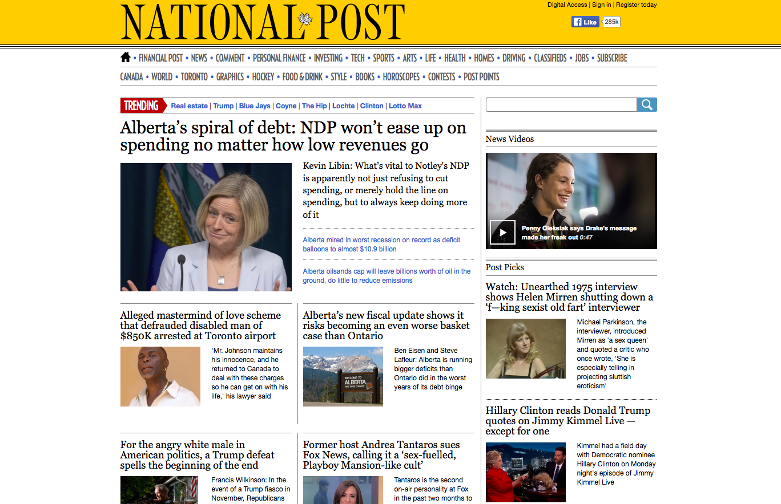

Slide 19
It’s probably not possible to speak about anything without framing it one way or another. But your use of framing language can limit or restrict the way things can be thought of, and spoken about. They can even prevent certain ways of thinking and speaking.
And when two or more people conversing with each other frame their topic differently, some unnecessary conflict can result, just as if they were starting from different premises or presupposing different world views.
So it can be important to monitor one’s own words, and know what frame you are using, and whether that frame is assisting or limiting your ability to think and speak.
It can also be important to listen carefully to the framing language used by others, especially if a difference between their framing language and yours is creating problems.
16

Slide 20
Problems
Usually, logic and critical thinking skills are invoked in response to a need. And often, this need takes the form of a problem which can’t be solved until you gather some kind of information.
Sometimes the problem is practical: that is, it has to do with a specific situation in your everyday world.
The problem could also be theoretical: in that case, it has to do with a more general issue which impacts your whole life altogether, but perhaps not any single separate part of it in particular. Religious and philosophical questions tend to be theoretical in this sense.
17

Slide 21
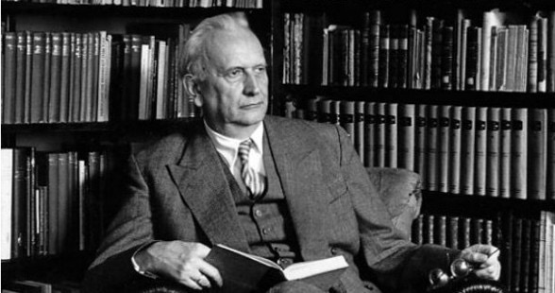
The philosopher Karl Jaspers described a special kind of problem, which he thought was the origin of philosophical thinking. He called this kind of problem a Grenzsituationen, a “limit situation”.
18

Slide 22
Limit situations are moments, usually accompanied by experiences of dread, guilt or acute anxiety, in which the human mind confronts the restrictions and pathological narrowness of its existing forms, and allows itself to abandon the securities of its limitedness, and so to enter new realm of self-consciousness.
In other words, a limit situation is a situation that more or less forces you to acknowledge that your way of thinking about the world so far has been very limited, and that you have to find new ways to think about things in order to solve your problems and go ahead with your life.

Slide 23
A limit situation doesn’t have to be the sort of circumstance which provokes a nervous breakdown or a crisis of faith, nor does it have to be a matter of life and death.
But it does tend to be the situation in which your usual and regular habits of thinking just can’t help you.
It can also be a situation in which you have to make a decision of some kind, which you know will change your life in a non-trivial way.
19

Slide 24
Observations
Thus far, we have noted the problems that tend to get thinking started, and the background in which thinking takes place. Now we can get on to studying thinking itself. In the general introduction, I wrote that clear critical thinking involves a process. The first stage of that process is observation.
20

Slide 25
When observing your problem, and the situation in which it appears, try to be as objective as possible.
Being objective, here, means being without influence from personal feelings, interests, biases, or expectations, as much as possible.
Although it might be impossible to be totally, completely, and absolutely objective, still it certainly is possible to be objective enough to understand a situation as clearly and as completely as needed, to make a good decision.
21
Notes:
Being objective means you look at things as 100% fact based as possible, you don’t let emotions or personal biases influence your decisions.

Slide 26
Here are some guidelines that can help maintain your objectivity.
• Take stock of how clearly can you see or hear what is going on. Is something obstructing your vision? Is it too bright, or too dark?
• Describe your situation in words, and as much as possible use value-neutral words in your description.
• Describe, also, how your situation makes you feel.
• Observe what your instincts and intuitions are telling you.
• Take note of anything in the situation that can be counted, or measured mathematically:
• Take note of where your attention seems to be going.
• If your problem is related to some practical purpose, take note of everything you need to know in order to fulfill that purpose.
• If other people are also observing the situation with you, consult with them.
22

Slide 27
An exercise: which of the following are observations, and which are probably judgments?
That city bus has too many people on it.
The letter was delivered to my door by the postman at 10:30 AM.
The two of them were standing so close to each other that they must be lovers.
The clothes she wore suggested she probably came from a very rich family.
The kitchen counter looked like it had been recently cleaned.
He was swearing like a sailor.
The old television was too heavy for him to carry.
There’s too much noise coming from your room, it’s driving me crazy!
The latest James Bond film was a lot of fun.
The latest James Bond film earned more than $80 million in its first week.
23

Slide 28
Questions
Perhaps more than the problems do, good questions get the mind thinking as well. Indeed we might not fully understand the nature of a given problem until we have asked a decent question about it.
But some kinds of questions are better than others, and it can be important to discern the difference between them.
24

Slide 29
Good questions are:
Tenacious
Useful
Direct
Open
Searching
Fertile
Systematic
Controversial
25
Notes:
Direct: the question is asked in the most simple way
Open: the question has more than one answer
Fertile: The question can lead to more questions
Controversial: A question where someone with power don’t necessarily want you to ask. A controversial question is one that very few people are asking. (Is trump racist?)

Slide 30
There are also several kinds of bad questions.
Rhetorical
Obstructionist
Leading
Framing
Loaded
Empty
26
Notes:
Rhetorical Question: A question that is a statement disguised as a question. It makes people think about something that they wouldn’t otherwise.
Leading Question: Appears in a series of questions that is build in a way to make you think in one way and pull an answer out of you that you wouldn’t otherwise answer.
Loaded Question: A question where you cannot give a straight answer unless you assume something implied in the question that you don’t want to assume.
Obstructionist Question: Question where the question isn’t appropriate and the context in which it is asked, but would be totally appropriate in another context. Derails the conversation.
Framing Question: not possible unless you accept the same frame in which the question is posed.
Empty Questions: A question that has no answer. A question that any answer you might give is kind of pointless, they teach you nothing you might not already know.

Slide 31
Differing World Views
You probably subscribe to several world views at the same time, some religious, some political, some cultural, some philosophical or scientific.
In fact you probably subscribe to one or two world views without consciously realizing it.

Slide 32
Again, there’s nothing wrong with having a world view: we probably wouldn’t be able to think about anything if we didn’t have one.
But not all world views are equal. Some are problematic, whether in great or small ways. Some are seriously faulty. If some part of your world view is faulty, this can muddle your thinking, and create conflict between you and other people.
Thus it is very important to learn to tell the difference between a faulty world view, and an acceptable one.
28

Slide 33
Some world views are faulty because their ideas concerning the nature of the world have been proven false through scientific research, such as:
The Ptolemaic model of the solar system
The ‘four elements’ theory of the nature of matter.
The ‘four humours’ theory of medicine.

Slide 34
Others are faulty because their consequences have turned out to be morally or politically destructive, such as:
Mediaeval feudalism
Soviet communism
Racism, sexism, homophobia, etc.
Nazism

Slide 35
Some faulty world views have a few features that people might find appealing. For example:
The way the sun rises and sets makes it look as if the Earth is at the centre of the solar system.
The ‘four humours’ theory of medicine corresponds elegantly to the ‘four elements’ theory of matter.
Under Soviet communism, from Stalin’s time until the fall of the Berlin wall, absolutely nobody was unemployed.
In Germany when the Nazi party was in power, productive and high-achieving workers could receive a free holiday, paid for by the government.
But these apparent benefits should not blind you to the empirical or moral failures of a faulty world view (some of which are now very obvious).

Slide 36
Schweitzer described three properties which he thought an acceptable world view must have. In his description, an acceptable world view must be:
Rational,
Ethical,
and Optimistic.

Slide 37
An acceptable world view is rational when it is the product of sustained rational thought about the way things really are.
“Only what has been well turned over in the thought of the many, and thus recognised as truth, possesses a natural power of conviction which will work on other minds and will continue to be effective. Only where there is a constant appeal to the need of a reflective view of things are all man’s spiritual capacities called into activity.”
(Schweitzer, ibid pg. 86-7.)
Schweitzer stipulates this in order that the acceptable world view may help people come to a useful understanding of the world, and of one another. A world-view derived from unreflective instincts and impulses, in his theory, cannot properly reflect reality, nor will it have sufficient power to motivate people to take action.

Slide 38
An acceptable world view is ethical when it can tell us something about the difference between right and wrong, and when it can help us become better human beings.
“Ethics is the activity of man directed to secure the inner perfection of his own personality...
“From the ethical comes ability to develop the purposive state of mind necessary to produce action on the world and society, and to cause the co-operation of all our achievements to secure the spiritual and moral perfection of the individual which is the final end of civilization.”
(ibid pg. 94-5)

Slide 39
An acceptable world view is optimistic when it presupposes that life on earth is valuable and good.
“That theory of the universe is optimistic which gives existence the preference as against non-existence and thus affirms life as something possessing value in itself.
From this attitude to the universe and to life results the impulse to raise existence, in so far as our influence can affect it, to its highest level of value.
Thence originates activity directed to the improvement of the living conditions of individuals, of society, of nations and of humanity.”
(Schweitzer, ibid, pp. 93-4)

Slide 40
An acceptable world view, according to Schweitzer, is rational, ethical, and optimistic.
A world view that is not rational, not optimistic, and not ethical, whether in whole or in part, is (to that extent) a problematic or a faulty world view.

Slide 41
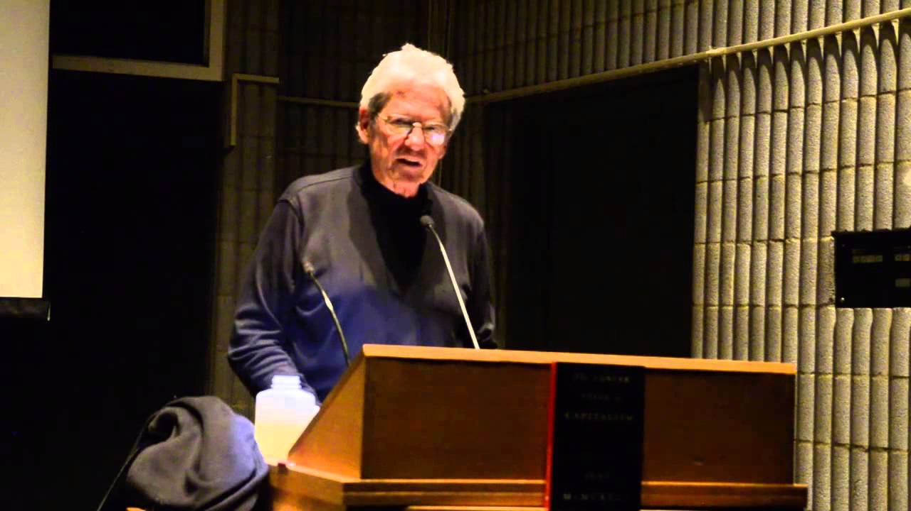
Value Programs
One type of faulty world view is the kind which Canadian philosopher John McMurtry referred to as a “value program”.

Slide 42
Here is McMurtry’s own definition of a value program.
In the pure-type case, which will be our definition of a value program, all people enact its prescriptions and functions as presupposed norms of what they all ought to do. All assume its value designations and value exclusions as givens. They seek only to climb its ladder of available positions to achieve their deserved reward as their due. Lives are valued, or not valued, in terms of the system’s differentials and measurements. All fullfill its specified roles without question and accept its costs, however widespread, as unavoidable manifestations of reality. In the strange incoherence of the programmed mind, the commands of the system are seen as both freely chosen and as laws of nature, or God…
A value program is what happens when the ethical component of one’s world view contains propositions that cannot be questioned under any circumstances, even when their practical application turns out to be destructive to human and environmental life.
Cont. -->

Slide 43
Those who are harmed by the value program are ignored, or else blamed for falling on its wrong side, because its rule is good and right. Its victims must, it is believed, be at fault. A value program’s ideology is in great part devoted to justifying the inevitability of the condition of the oppressed.
McMurtry, “Unequal Freedoms” (Garamond, 1998) pg. 6

Slide 44
A short version of McMurtry’s definition might go like this:
A value program is a system of thinking about values (right and wrong, good and evil, what must be done, etc) which takes itself to be an absolute and universal truth, and thus allows for no critical questioning and no flexibility, even when fulfilling its requirements causes enormous harm to people and environments, and even when its propositions run contrary to the observable facts of reality.

Slide 45
McMurtry’s explanation goes a little further:
This is a common pattern that holds across nations, classes, races, and individuals, From ancient caste systems to contemporary genocides of “development”, we can see the life-blind destructions of value programs in motion holding entire peoples in thrall. But it is not “human nature” that is the problem. The problem is not in how we are constructed, but in the inert repetition of the mind, a condition that does not question socially conditioned value programs.
McMurtry, ibid, pg. 6

Slide 46
It’s usually easy to identify value programs from history: mediaeval feudalism, for instance. But perhaps the more philosophical questions are:
What are the value programs of our time?
What are the unquestionable propositions of the value programs of our time?
In what ways, (if at all), do these value programs fail to meet Schweitzer’s criteria?
Are you, or the people around you, or the society you live in, unknowingly subscribing to one?

Slide 47
World Views, Civilizations, and Conflict.
In 1993, American historian and political scientist Samuel Huntington published a paper called “A Clash of Civilizations?” In that paper he defined ‘civilization’ as:
“the highest cultural grouping of people and the broadest level of cultural identity people have short of that which distinguishes humans from other species.”
Huntington, “A Clash of Civilisations?” Foreign Affairs, Summer 1993
In other words, a civilization is the largest possible grouping of people who identify with (roughly) the same world view - such that the only larger group is the human race as a whole.

Slide 48
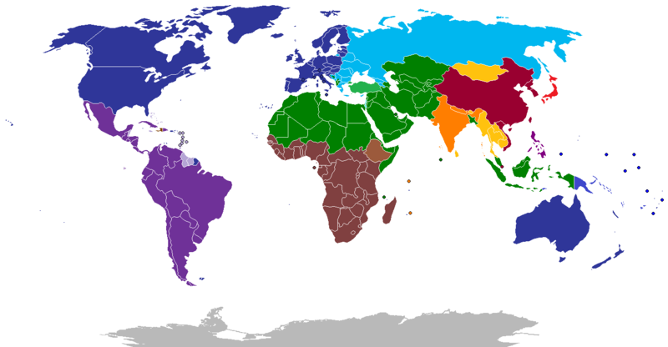
With that definition in mind, Huntington reasoned that there are seven active civilizations in the world right now.

Slide 49
Huntington further argued that differences in world view and civilization are going to be the basis for all future armed conflict.
“…the fundamental source of conflict in this new world will not be primarily ideological or primarily economic. The great divisions among humankind and the dominating source of conflict will be cultural. Nation states will remain the most powerful actors in world affairs, but the principal conflicts of global politics will occur between nations and groups of different civilizations.”
Huntington, ibid.

Slide 50
Huntington also gives a special place to religion. In his view, economic globalisation has had the effect of reducing the importance of the nation-state in shaping and defining personal identity. Religion, he says, has taken its place, since religion:
“…provides a basis for identity and commitment that transcends national boundaries and unites civilizations.”
(ibid.)
Is Huntington right?
Why, or why not?

